Slide 1
Internet Applications
CSCE 3420

Slide 2

Class resources
LinkedIn Learning
Great resource because you are a UNT student

Slide 3
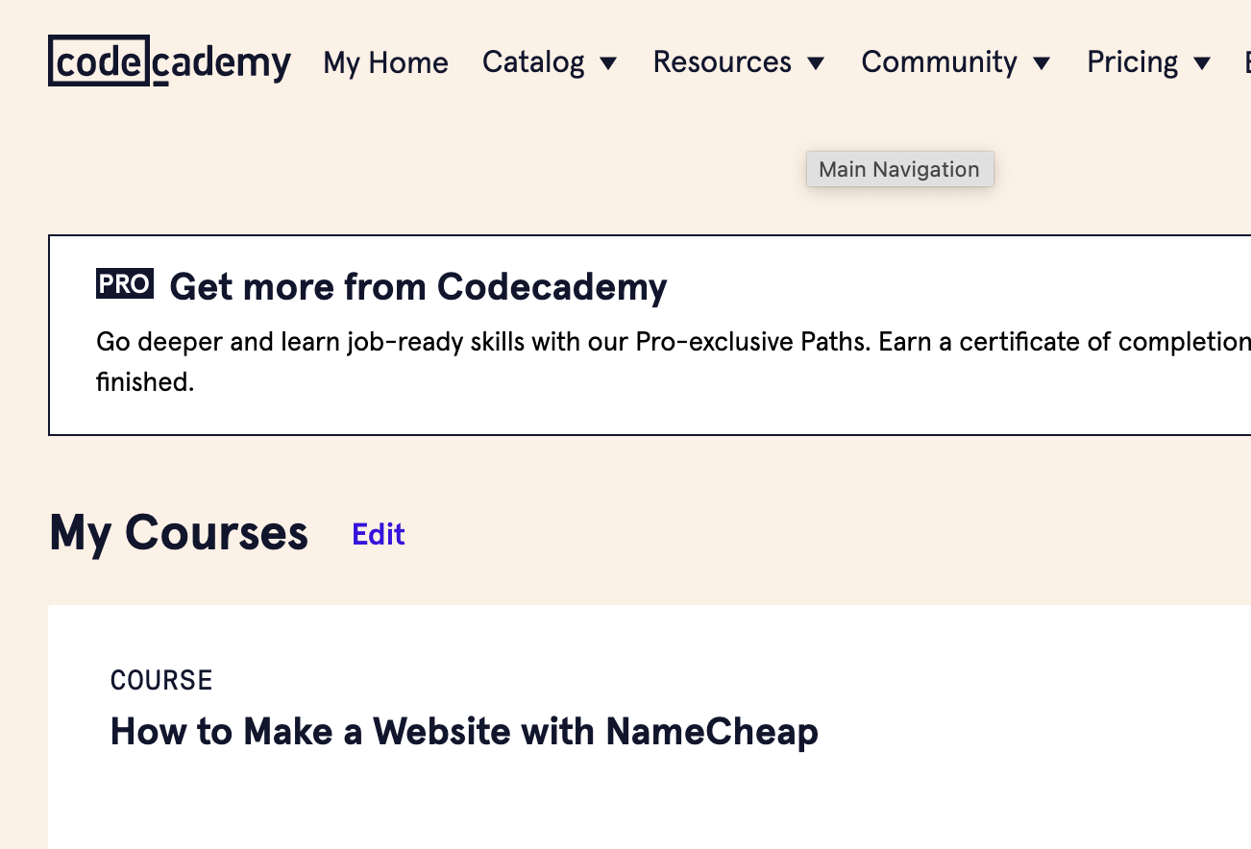
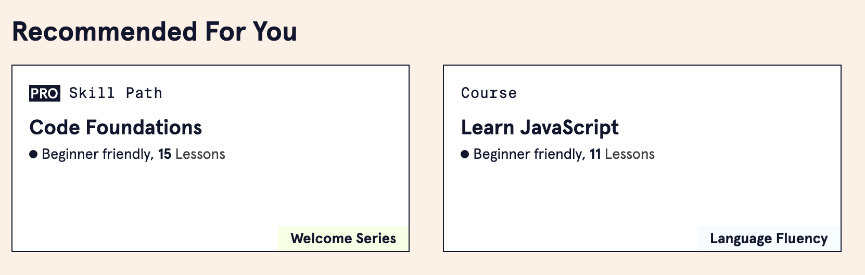
Codeacademy
Lots of great classes that are free
Do not go with the subscription path

Slide 4
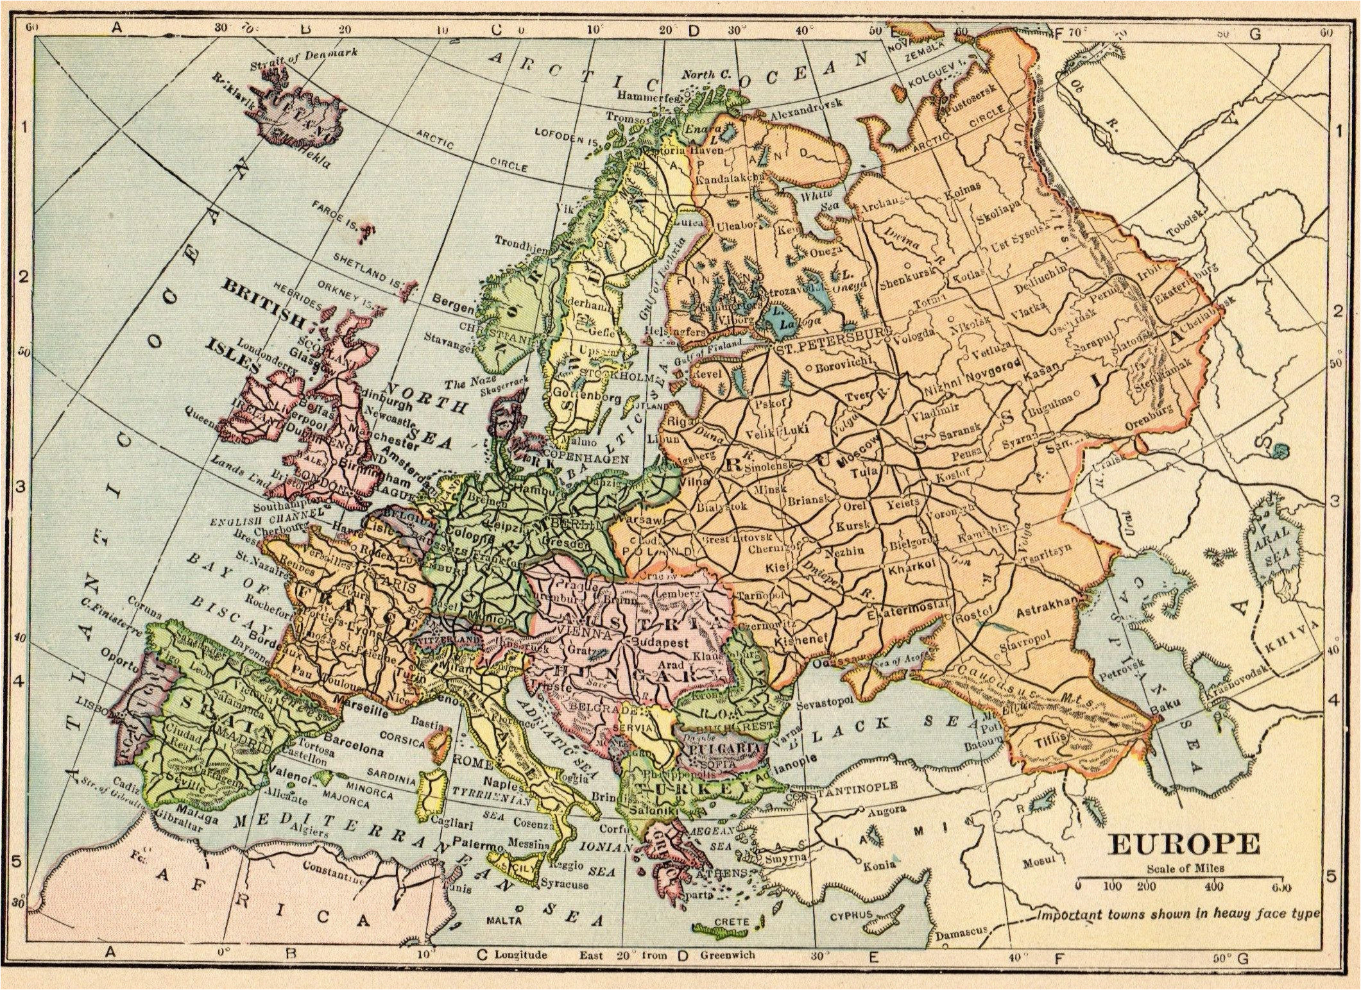
Europe around WW II
Note the interconnecting ‘web’ of highways

Slide 5
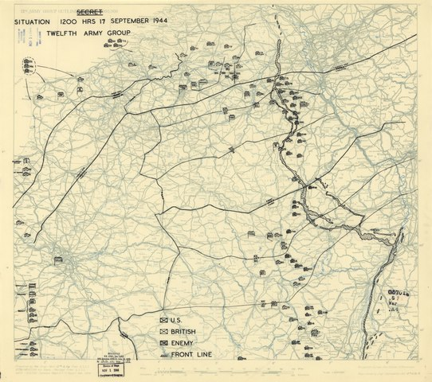
Allies Supply Lines Sept 1944
Note how the Allied Forces took advantage of that web

Slide 6
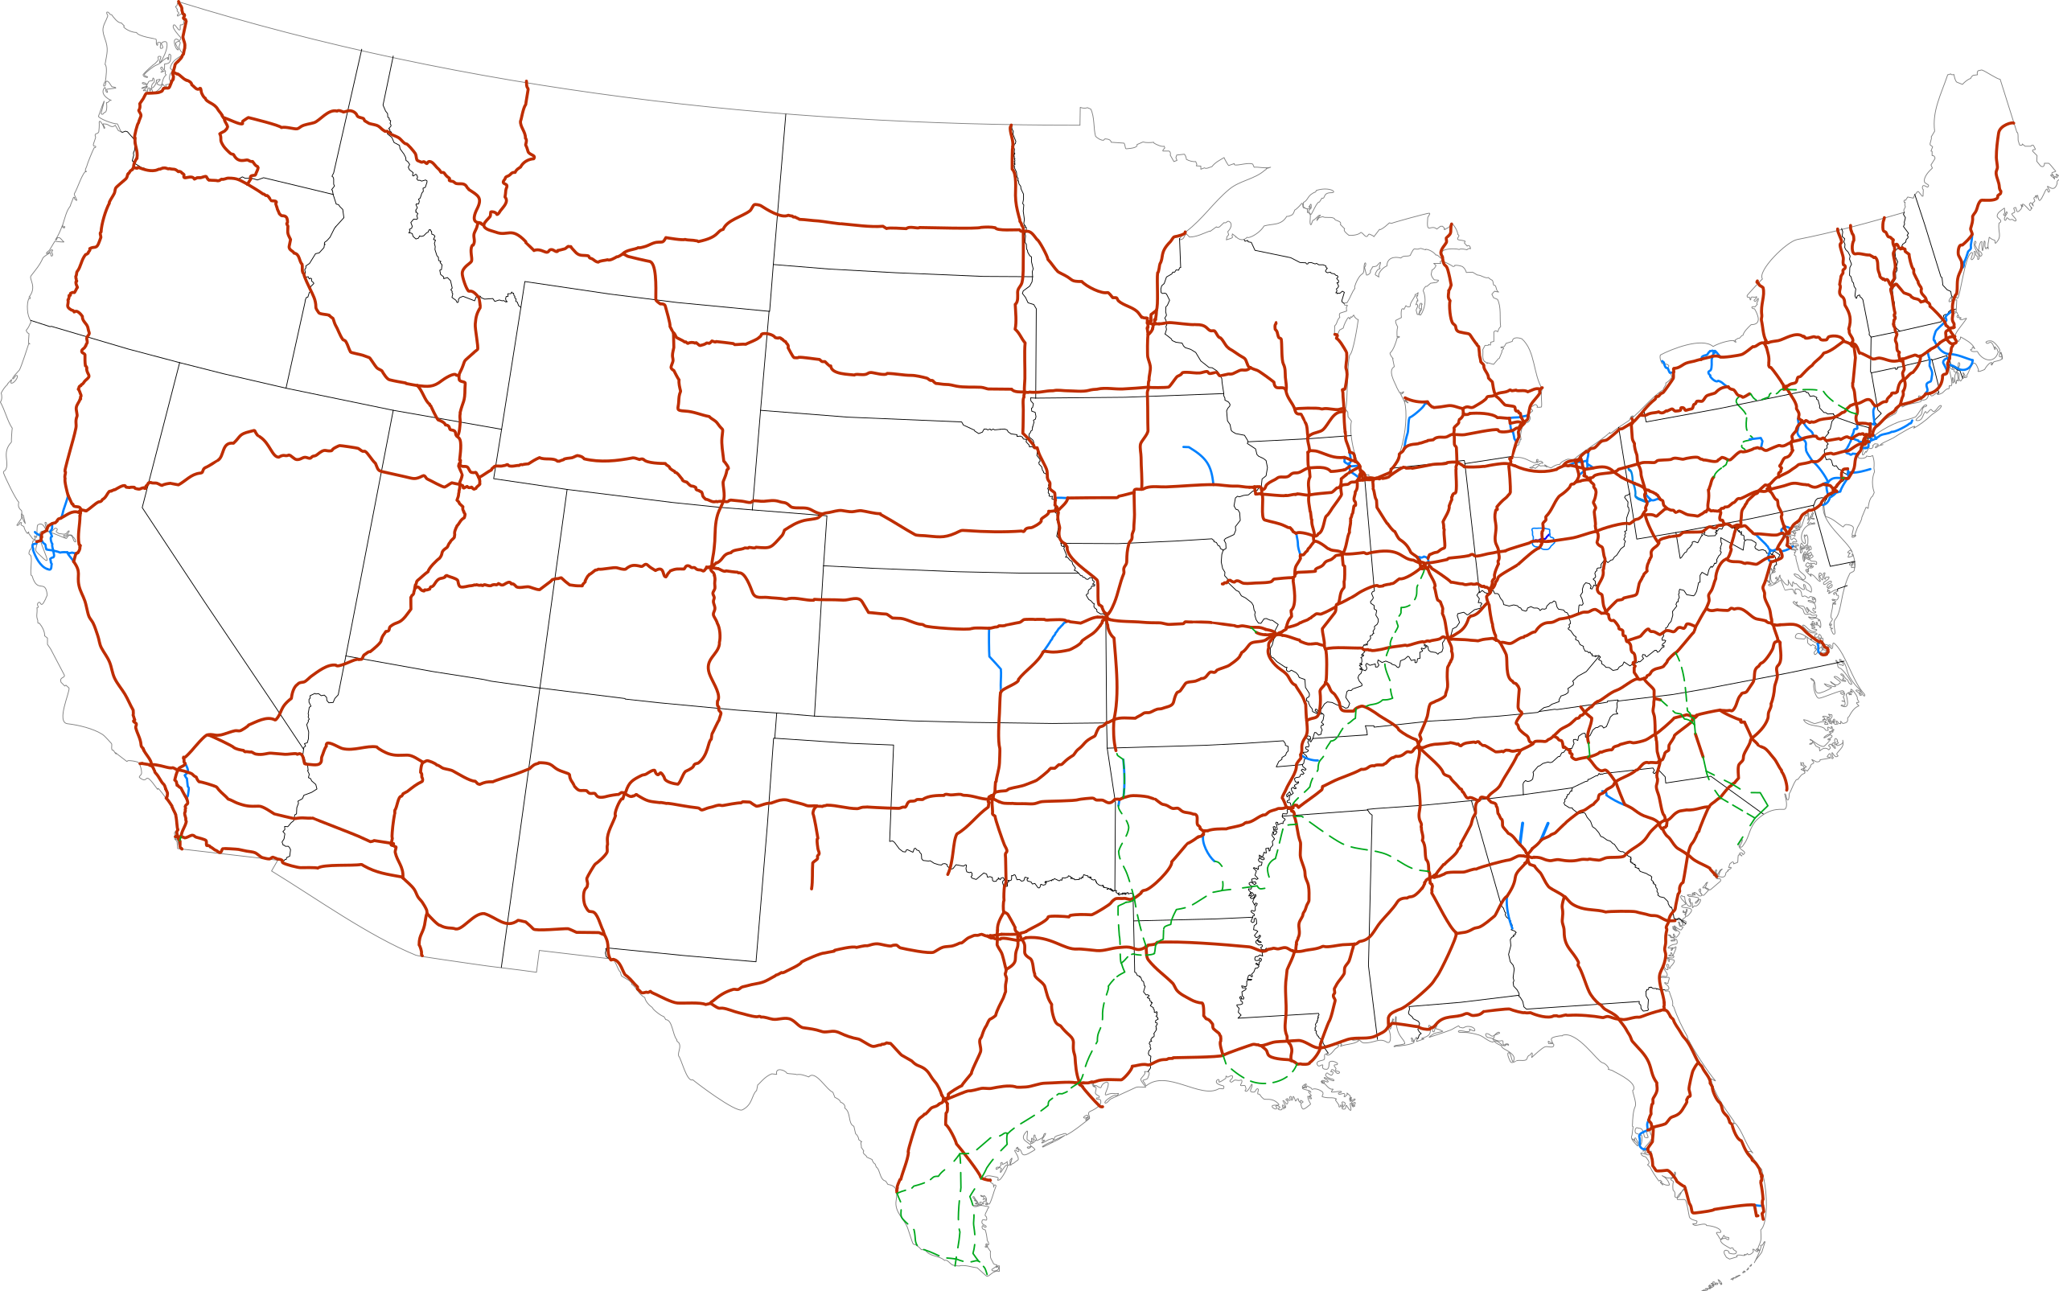
US Interstate System Thank you, Europe and General Eisenhower
National System of Interstate and Defense Highways

Slide 7
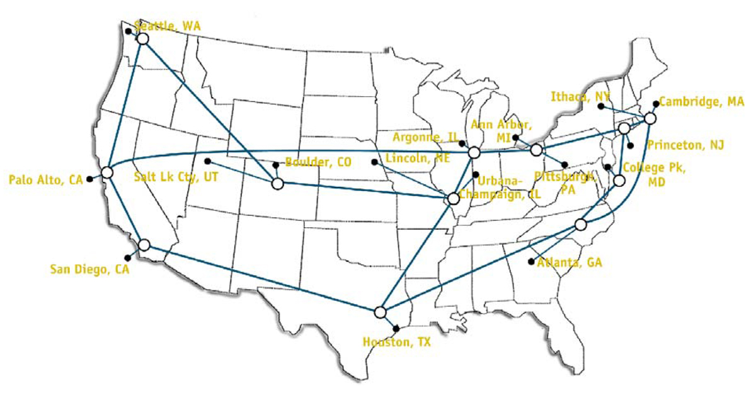
T3 Network 1992

Slide 8
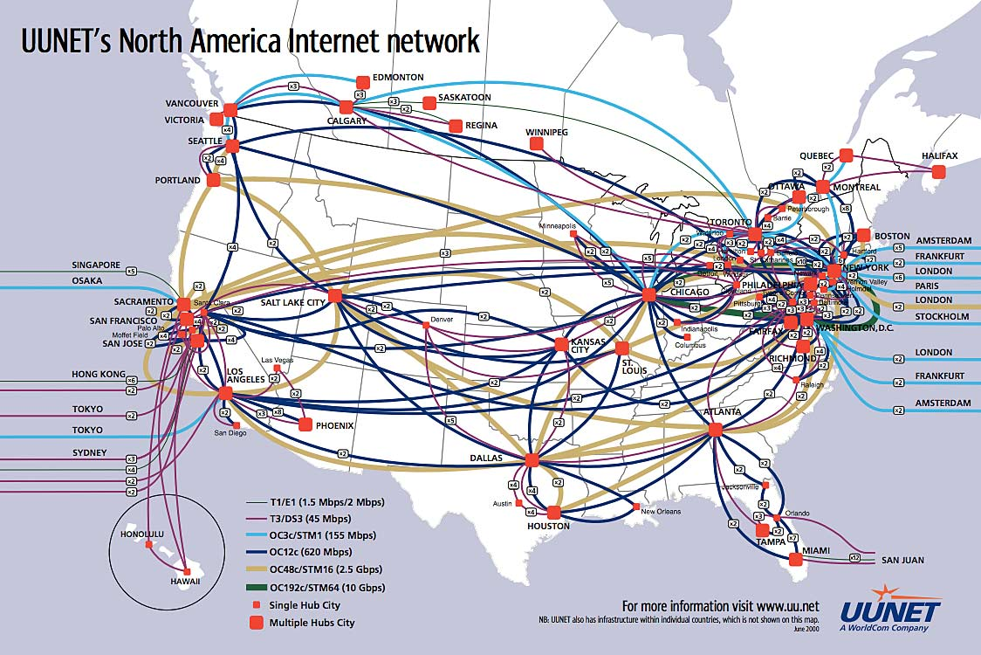
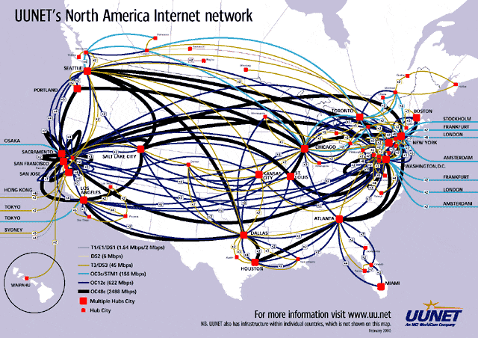
You’ve come a long way baby

Slide 9
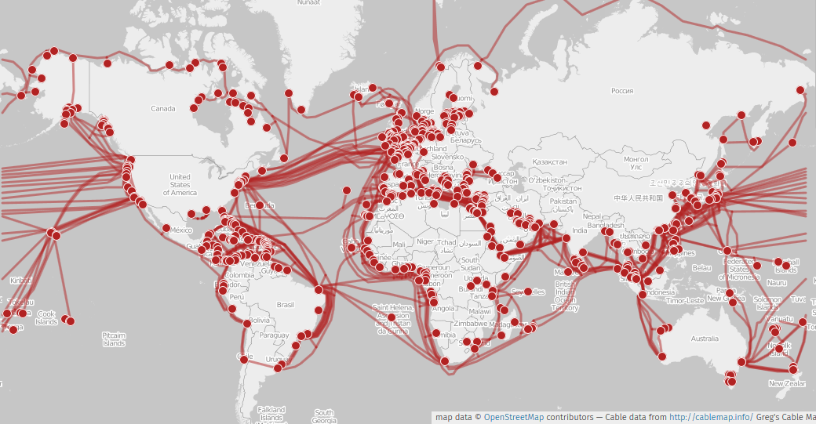
Undersea Cables

Slide 10
Protocols
Protocols facilitate polite social interaction. If we follow the rules no ones gets stabbed
HTTP
SMTP
TCP/IP
Notes:
The Japanese Greeting Respect between colleagues and business partners is greatly emphasized in Japan. The Japanese greet one another with a bow, signifying honor between them. It is believed that the lower the bow, the higher the significance of respect the person holds. Gently bow with your head lowered, with your hands on either side of your body to make a good impression. If the person extends their hand for a handshake, you can return that alongside a bow to make for a complete greeting. Common times that call for this Japanese business culture are – the beginning and end of the ceremony, to express gratitude, to show empathy, while asking for a favor, or while bidding goodbye.
Exchanging Business cards Known as Meishi in Japanese, exchanging business cards is considered an important professional etiquette in Japan. The appearance and handling of Japanese visiting cards are considered an important characteristic of a person’s reputation for the Japanese. We recommend carrying a suitable case for your business cards so that they don’t look all crammed up and are well-pressed. When someone hands you their business card, examine it carefully and place it front-facing on your desk, to show respect for them.
Removal of shoes While attending any informal event, enter only after removing your shoes. In the Japanese business culture, the removal of shoes before entering any important place is quite a thing! Show some respect for the custom by leaving your footwear outside. Also, remember to have some clean socks on, walking barefoot may be frowned upon.
Punctuality Sticking to timelines and deadlines is a sure-shot yes while doing business in Japan. The Japanese value reliability and need to trust you before they go ahead with any partnership. Keep a close look at the time and be observant. If due to an unavoidable circumstance, you aren’t able to follow through with the deadline, make sure to notify your colleagues and seniors in advance.
Body Language Be mindful of your body language. Excessive touching, laughter, or dramatic expressions are better to avoid while meeting with the Japanese. A firm back, straight shoulders and a solemn look go a long way in impressing your clients and colleagues. The Japanese are serious people when it comes to doing business and their communication etiquette, so avoid making any jokes or remarks that could offend the person or company.
Dress Code A black or grey suit with a white shirt, tie, and formal pants for men and a mild colored shirt to go with a formal skirt for women can be followed to set the business attitude tone in your attire.

Slide 11
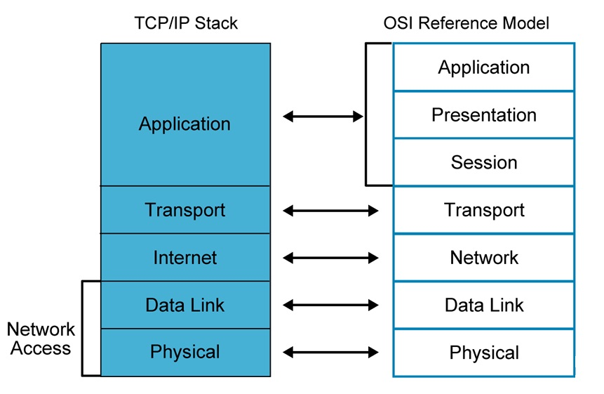
Comparing TCP/IP Stack with OSI Reference Model
https://www.cloudflare.com/learning/ddos/glossary/open-systems-interconnection-model-osi/
Notes:
Tcp/Ip (Transmission Control Protocol / Internet Protocol
Open Systems Interconnection

Slide 12
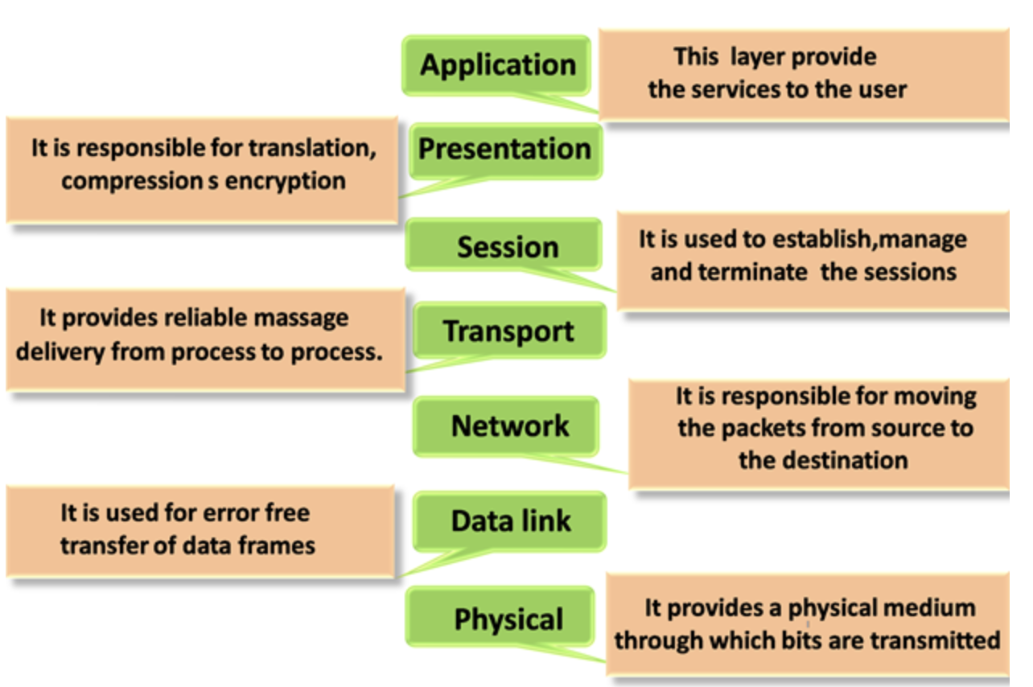
OSI

Slide 13
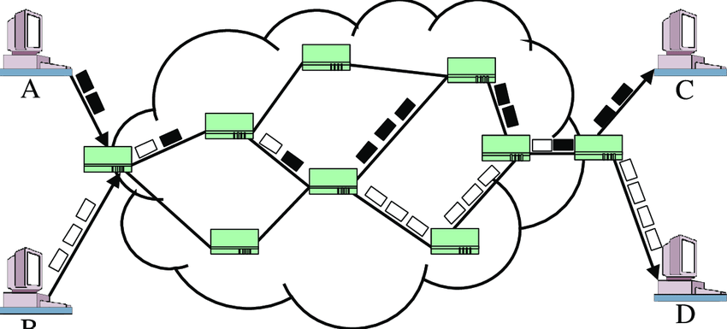
Packet Switching Network
Notes:
Packets are numbered and counted
Leave no packet behind

Slide 14
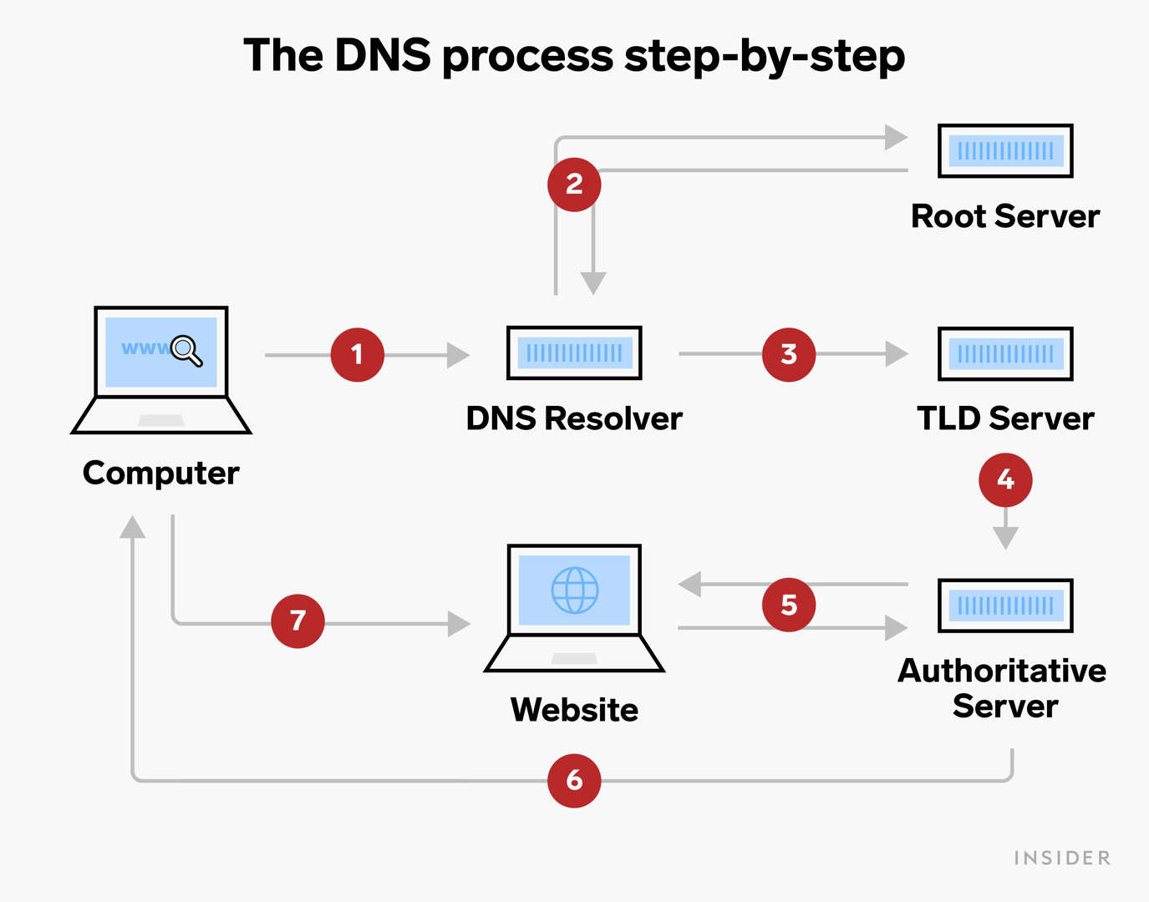
From URL to IP address
Domain Name System
Translates your www.Facebook.com to a physical IP address
31.13.93.35
Enter this into your browser. It will load Facebook

Slide 15
Getting the IP address of a server
Ping
Traceroute or tracert
NSlookup

Slide 16
Directions to Discovery Park
I ask for directions to Discovery Park
Converts speech to text
Uses language analysis to determine my request is for directions
Passes that request off to the designated server
The GPS server determines if it is a valid destination
Converts Discovery Park to a Geo Location
Determines the fastest (and alternate routes to DP)
Presents the individual steps on my dashboard

Slide 17
Name that Port
Ports 20 and 21: File Transfer Protocol (FTP). Transfer files from client and server.
Port 22: Secure Shell (SSH). SSH is one of many tunneling protocols that create secure network connections.
Port 25: Simple Mail Transfer Protocol (SMTP)
Port 53: Domain Name System (DNS). DNS matches human-readable domain names to machine-readable IP addresses
Port 80: Hypertext Transfer Protocol (HTTP). Makes the WWW possible.
Port 123: Network Time Protocol (NTP). NTP allows computer clocks to sync with each other, a process that is essential for encryption.
Port 443: HTTP Secure (HTTPS). HTTPS is the secure and encrypted version of HTTP.

Slide 18
Each port severs a function
The previous slide showed some of the many server ports
A server is not relegated to a single task
A physical server can service multiple ports; database, web, email
But then they all compete for the same CPU resource
While they can reside on the same device they are usually segregated

Slide 19
What does a server do
Does an infinite loop
Listens for a request on a particular port
Responds to a request for a resource. The R of URL
File, HTML, JSON, JavaScript
Browser makes a request and waits for that response.
Until recently this was all HTML (we see more JSON now)
Causing the page to reload (or be dynamically created)
Notes:
Minecraft port 25565
MS SQL 1443

Slide 20
Terms
Client – the browser
Server – Destination resource to respond to Client request
Usually single purpose (web server and DB not on same machine)
HTML – Hyper Text Markup Language
HTTP – is the Hyper Text Transport Protocol
Stateless – doesn’t remember you from one visit to the next
User port 80
Text based

Slide 21
Terms
Cookies - How Amazon tracks you
A ‘session’ is created, and a cookie is saved on your computer
Which can be queried or given to the server to associate you with your cart in the database
They are used to establish and maintain an HTTP session
CRUD – Create, Read, Update, Delete

Slide 22
HTTP Verbs How we communicate with a server
HTTP Verb Corresponding CRUD action
GET Read
POST Create
PUT/PATCH Update
DELETE Delete

Slide 23
HTTP Response Codes
Informational responses (100–199)
Successful responses (200–299)
Redirects (300–399)
Client errors (400–499)
Server errors (500–599)
https://developer.mozilla.org/en-US/docs/Web/HTTP/Status

Slide 24
Have you ever seen a 418 error?
100 Continue
101 Switching Protocols
103 Early Hints
200 OK
201 Created
202 Accepted
203 Non-Authoritative Information
204 No Content
205 Reset Content
206 Partial Content
300 Multiple Choices
301 Moved Permanently
302 Found
303 See Other
304 Not Modified
308 Permanent Redirect
307 Temporary Redirect
400 Bad Request
401 Unauthorized
402 Payment Required
403 Forbidden
404 Not Found
405 Method Not Allowed
406 Not Acceptable
407 Proxy Authentication Required
408 Request Timeout
409 Conflict
410 Gone
411 Length Required
412 Precondition Failed
413 Payload Too Large
414 URI Too Long
415 Unsupported Media Type
416 Range Not Satisfiable
417 Expectation Failed
418 I'm a teapot
422 Unprocessable Entity
425 Too Early
426 Upgrade Required
428 Precondition Required
429 Too Many Requests
431 Request Header Fields Too Large
451 Unavailable For Legal Reasons
500 Internal Server Error
501 Not Implemented
502 Bad Gateway
503 Service Unavailable
504 Gateway Timeout
505 HTTP Version Not Supported
506 Variant Also Negotiates
507 Insufficient Storage
508 Loop Detected
510 Not Extended
511 Network Authentication Required

Slide 25
cURL
curl https://www.cnn.com
curl -o index.html https://www.cnn.com
curl -X POST http://www.cnn.com -d 'term=mars'
curl -X POST http://www.cnn.com -d 'term=mars' -o mars.html
curl --request GET \
--url 'https://imdb8.p.rapidapi.com/title/find?q=mars' \
--header 'x-rapidapi-host: imdb8.p.rapidapi.com' \
--header 'x-rapidapi-key: 498ed225bamshcd02cf5559e10edp179d21jsn59b140b93ec5'

